Slide 1



Vue.js 3.0 Workshop
Preetish H S
preetish.in
/in/preetishhs

Slide 2
What is Vue.js
Vue Is a progressive JavaScript framework
Easy to pick up and integrate with other libraries
Simple and flexible
Fast and small in size
Reactive
Component based
Notes:
What is progressive? It can be used only in part of the application, for a few pages also
Why is it easy? No tight typescript coupling like angular, no JSX like React, just normal HTML CSS and JavaScript.
Just import from CDN and that’s it. If you want the full SPA setup you can use official CLI to create the project.
Reactive -> Vue uses virtual DOM like react to update the changes and also supports 2 way binding even for custom elements.
Component based to make the code modular

Slide 3
Pre-requisites?
Intermediate level of knowledge in
HTML
CSS
JavaScript (ES6 Syntax)

Slide 4
Supporting libraries
Vuex – (Official state management library)
Vue-router – (Official router library)
Vue-i18n – (Internationalization library )
Vue-test-utils – (Unit testing library)
Vue-CLI – (Official CLI tool to bootstrap the project)
Notes:
1. Vuex to maintain state on client side such as keep user data, authentication data, or the data that is being used by multiple components
2. Vue router which is official routing library which we use to create a Single Page application
3. Vue i18n was initially a 3rd party library but is a part of official Vue ecosystem
4. Vue-test-utils again was initially 3rd party library but now being maintained by Vue core team.

Slide 5
Installation
CDN
CLI (recommended)

Slide 6
Course Contents - Day 1
Setting up project from CLI (node.js, vue-cli)
Folder Architecture
Template syntax
Data properties, computed properties, watchers, methods
Data binding (One way and two way)
Components (global and local)
Using Vue Devtools
Notes:
Hrs of workshop
20 hrs of Vue
2hrs of Javascript Refresher

Slide 7
Course Contents - Day 2
Directives, loops and conditional syntax
Lifecycle hooks
Component communication (props and emit)
Two-way binding for custom components
Dynamic components

Slide 8
Course Contents - Day 3
Slots, named Slots and scoped slots
Binding classes and styles (CSS)
Form input binding (Radio, Checkbox etc)
Events and event modifiers
Keyboard events and modifiers

Slide 9
Course Contents - Day 4
Making API Calls using Axios
Introduction to Mixins and code sharing

Slide 10
Course Contents - Day 5
Introduction to Vue router
Creating routes and navigation
Navigating via code
Dynamic routing and query parameters
Child routes / Nested routes
Handing 404 route

Slide 11
Course Contents - Day 6
Introduction to Vuex and State management
Storing and manipulating data in Vuex
Using Vuex in Components
Using Vuex helpers

Slide 12
Course Contents - Day 7
Namespaced store and modules
Navigation Guards (Local and Global)

Slide 13
Course Contents - Day 8
Introduction to Vue-i18n and Internationalization
Creating translation files
Using translation in templates and JavaScript
Switching languages
Number localization
Singular/plural localization
Date and time localization

Slide 14
Course Contents – Day 9
Introduction to Vue-test-utils and JEST
Mocking Data
Testing component output
Testing events
Testing Vuex
Building the application

Slide 15
Course Contents – Day 9
Introduction to Vue-test-utils and JEST
Mocking Data
Testing component output
Testing events and methods
Testing Vuex

Slide 16
Course Contents – Day 10
Testing Vuex
Mocking Async calls
Testing Router
Building the Application

Slide 17

JavaScript (ES6)
ES6 – ECMAScript 6 or ECMAScript 2015
ES6 is a next-gen of JavaScript
Important Concepts:
Let and Const
Arrow Functions
Array operations (es5)
Module Loaders
Spread Operator
De-structuring
Promises
Async / Await
Notes:
This is not an entire JavaScript course,
This JS refresher will cover some of the important concepts of ES6 that we’ll use often in our Vue course.

Slide 18
Let & Const
Let and Const are two new ways to declare variables in ES6
They are block scoped
Const is similar to let but once the value is assigned it cannot be reassigned. (If its an array or object it can be modified)

Slide 19
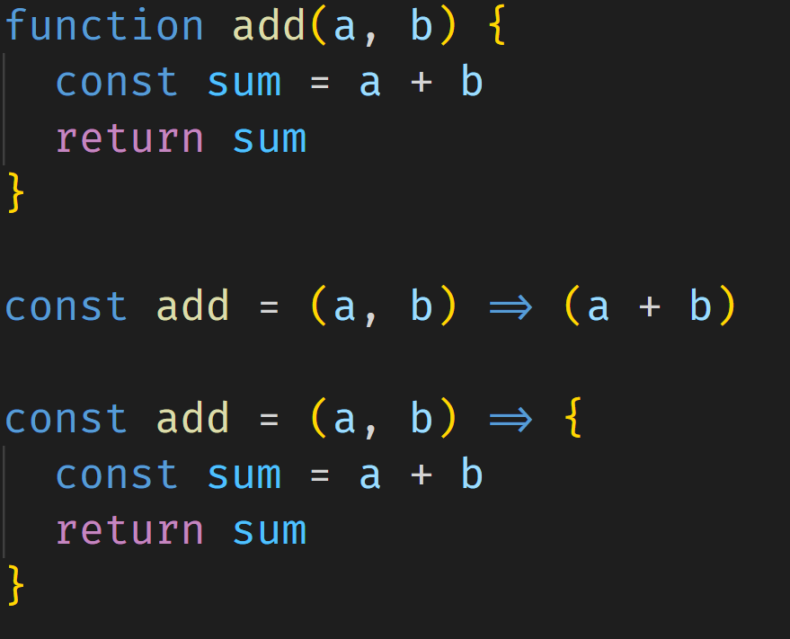
Arrow Functions
An arrow function expression is a compact alternative to a traditional function expressions

Slide 20
Array operations
forEach
map
filter
includes

Slide 21
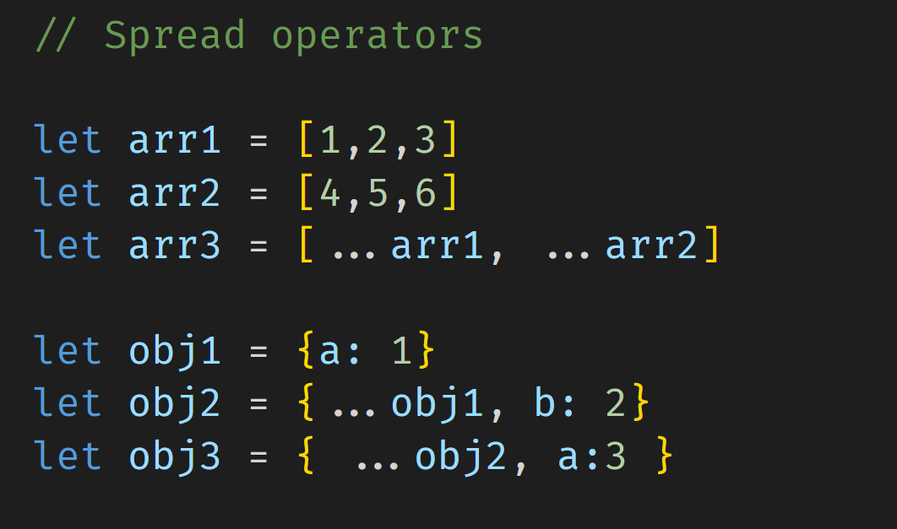
Spread Operator
Spread syntax (...) allows an iterable such as an array expression or an object to be expanded

Slide 22
De-structuring
The destructuring assignment syntax is a JavaScript expression that makes it possible to unpack values from arrays, or properties from objects, into distinct variables

Slide 23
Module Loaders
ES6 Provides a great way to import / export any JavaScript code and access them in other files or projects.
Named exports / imports
Default exports / imports

Slide 24
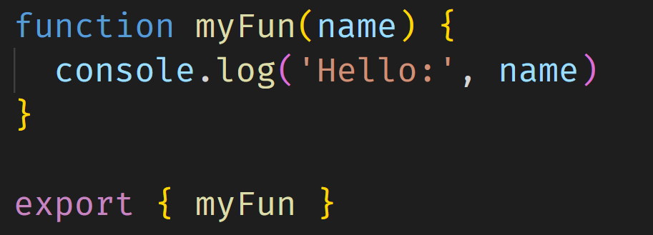
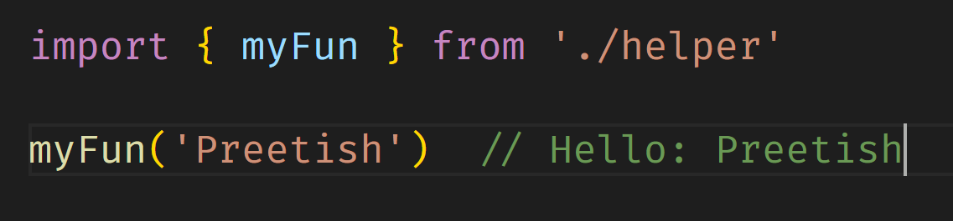
Module Loaders (Named)

Slide 25
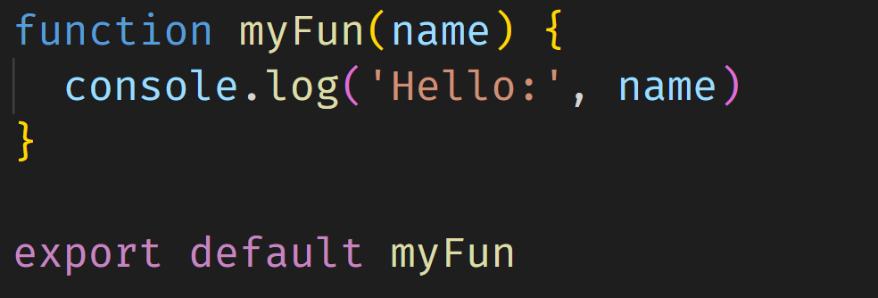
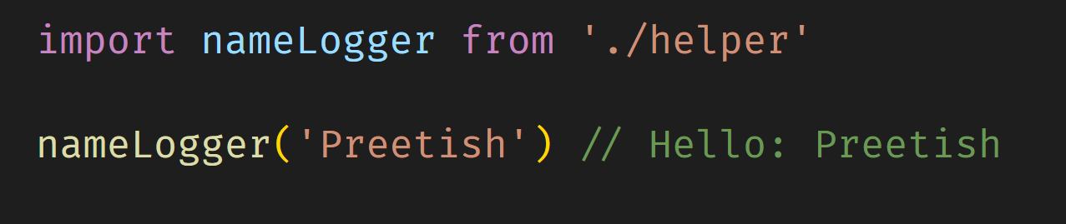
Module Loaders (Default)

Slide 26
Promises
A Promise is an object represents the eventual completion (or failure) of an asynchronous operation and its resulting value.
Promises lets asynchronous methods return values like synchronous methods.
States:
pending: initial state, neither fulfilled nor rejected.
fulfilled: meaning that the operation was completed successfully.
rejected: meaning that the operation failed.

Slide 27
Promises
function addNum() {
let a = 2
let b = 3
setTimeout(() => {
b = 5
}, 1000)
console.log('sum =', a + b)
}

Slide 28
Promises
function addNumWithPromise() {
let a = 2;
let b = 3;
let P = new Promise((resolve, reject) => {
setTimeout(() => {
b = 5;
resolve();
}, 1000);
});
P.then(() => {
console.log('sum =', a + b);
});
}

Slide 29
Async / Await
The async and await keywords enable asynchronous, promise-based behavior to be written in a cleaner style.
The function should start with async keyword
Notes:
Is Async/await better than promise?

Slide 30
Let’s See some code!

Slide 31
Create Vue App
We use Vue CLI to bootstrap the new app. After installing the CLI just run the command and follow the steps
npm install –g @vue/cli
vue create <project-name>
Notes:
The CLI creates webpack based project.
webpack is an open-source JavaScript module bundler. It is made primarily for JavaScript, but it can transform front-end assets such as HTML, CSS, and images if the corresponding loaders are included.

Slide 32
Vue Concepts
SPA (Single File Application)
Vue SFC (Single File Component)
Virtual DOM
Notes:
SPA: A single-page application (SPA) is a web application or website that interacts with the user by dynamically rewriting the current web page with new data from the web server
Virtual DOM is representation of traditional DOM in JavaScript.
A file with .vue extension is called as Vue Single File Component. It’s a single file where you can write HTML, JavaScript and CSS at the same place. Browser cannot understand .vue file, It requires traditional HTML, CSS and JS
vue-loader will parse the file, extract each language block, pipe them through other loaders if necessary, and finally assemble them back into an ES Module whose default export is a Vue.js component options object.
Vue loader, Sass loader, babel etc.

Slide 33
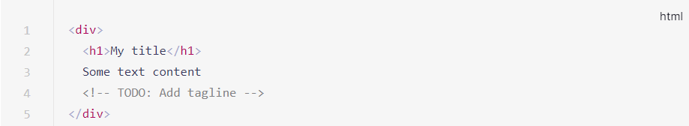
DOM
Notes:
Virtual DOM is representation of traditional DOM in JavaScript. The virtual DOM is also smaller in size than the actual DOM and so is very efficient.
Finding an element in the DOM directly is a much slower process than finding it on the JavaScript object.

Slide 34
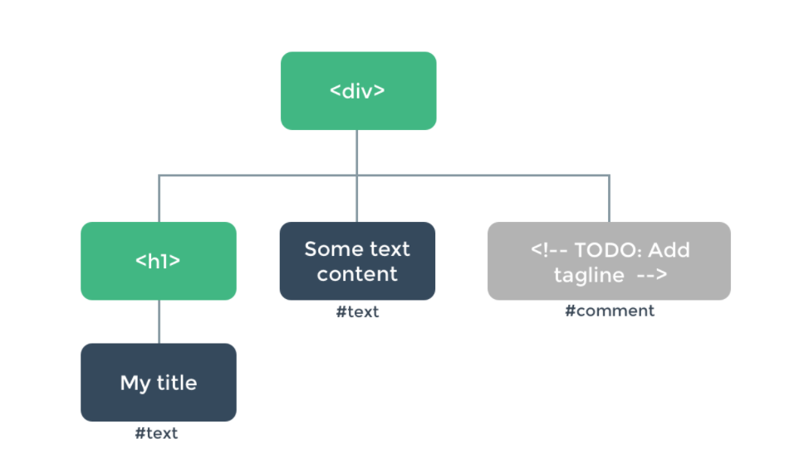
HTML DOM

Slide 35
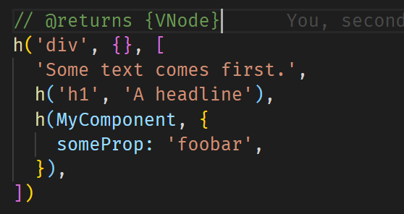
Virtual DOM
Notes:
Virtual DOM is representation of traditional DOM in JavaScript.
The virtual DOM is also smaller in size than the actual DOM and so is very efficient.
Finding an element in the DOM directly is a much slower process than finding it on the JavaScript object.

Slide 36
Vue Component (SFC)
<template>
<!–- html goes here -->
</template>
<script>
// script goes here
</script>
<style lang=“scss”>
// Css goes here
</style>
Notes:
CreateApp -> Creates and returns a Vue instance

Slide 37
main.js (The Entry point)
import { createApp } from 'vue'
import App from './App.vue'
createApp(App).mount('#app')
Notes:
CreateApp -> Creates and returns a Vue instance
Multiple Vue Instances

Slide 38
Vue Options API
data - to have local reactive data
Methods - functions to perform some operations
Computed - simple expressions
Watch - used to watch a data or computed property
Notes:
Options API and Composition API

Slide 39
Template Syntax (Interpolation)
<template>
<h1> {{ title }} </h1>
</template>
<script>
export default {
data() {
return {
title: 'My Blog'
}
}
}
</script>

Slide 40
Event Handing
We can use the v-on directive to listen to DOM events and run some JavaScript when they’re triggered
<template>
<button v-on:click="login"> Login </button>
<button @click="signup"> Sign Up </button>
</template>
<script>
export default {
methods: {
login() {},
signup() {}
}
}
</script>

Slide 41
Data Binding
To Use the data in our template tag attributes we need to bind them
To bind data to the we use v-bind directive.
<template>
<img v-bind:src="link" :width="width" />
</template>
<script>
export default {
data() {
return {
link: 'https://example.com/img.jpg',
width: '200px'
}
}
}
</script>
Notes:
A directive is some special token in the markup that tells the library to do something to a DOM element

Slide 42
Two way binding
Vue provides a special directive v-model for two-way binding on input elements. With two way binding whenever you change the input, the data will also be updated automatically.
<template>
Name: <input v-model="name" />
</template>
<script>
export default {
data() {
return {
name: ''
}
}
}
</script>

Slide 43
Components
We can create multiple components (.vue) and use them inside any other components(.vue)
<template>
<HeaderView />
<Todo />
<FooterView />
</template>
<script>
import Todo from '@/components/Todo'
export default {
components: {
Todo
}
}
</script>

Slide 44
Component Registration
Local (importing whenever required)
Global (registering it once and using it anywhere without having to import)

Slide 45
Component Communication
To pass data between components we use props and emits
Passing data to child Components via props
Emitting data back to parent components via events

Slide 46
Directives
Directives in Vue start with ‘v-’ and are generally used directly on the HTML tag in the template section to apply special reactive behavior to the rendered DOM.
Commonly used Directives:
v-bind
v-on
v-if (v-else-if and v-else)
v-show
v-for

Slide 47
Lifecycle Hooks
Lifecycle Diagram https://v3.vuejs.org/images/lifecycle.svg
lifecycle hooks are the defined methods which get executed automatically in a certain stage of the Vue component lifespan. starting from the initialization, to when it gets destroyed

Slide 48
Lifecycle Hooks
beforeCreate - a vue object is instantiated
Created - the object and its events are fully initialized (data, methods etc. are available)
beforeMount - Checks if any template is available in the object to be rendered in the DOM
Mounted - creates the renderable element. replaces the DOM element with this new data
beforeUpdate - gets fired before the changes reflecting the original DOM element.
Updated – gets fired after the changes get rendered on the screen by actually updating the DOM object
beforeUnmount - just before the vue object gets destroyed
Unmounted - gets invoked after successfully running destroy on the object and is removed from memory

Slide 49
Lifecycle Hooks
Useful Lifecycle Hooks:
Created
Mounted
beforeUnmount

Slide 50
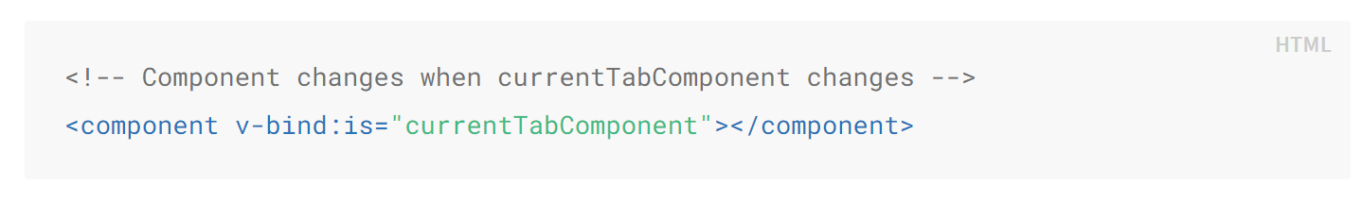
Dynamic Components
Sometimes, it’s useful to dynamically switch between multiple components
Eg: For building tabs component, user profile section

Slide 51
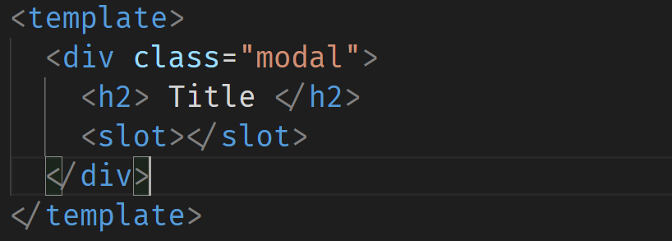
Slots
Slots are a mechanism for Vue components that allows you to compose your components and place content in new places or make components more generic.
Eg: For building Modals
Modal.vue

Slide 52
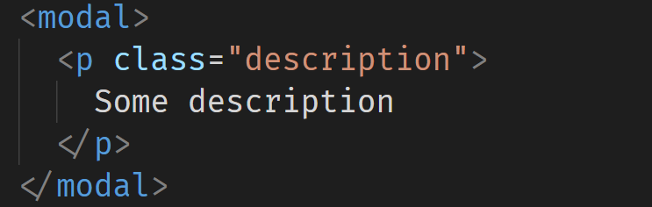
Slots
In the parent component

Slide 53
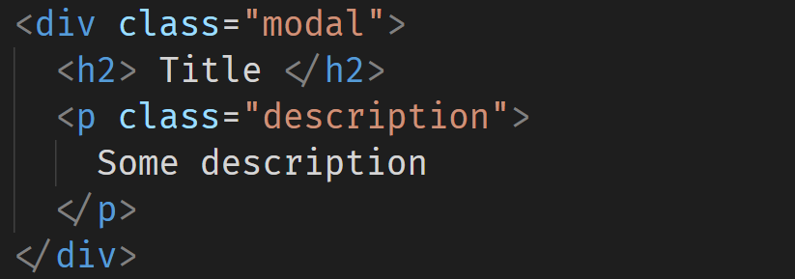
Slots
Final Rendered structure

Slide 54
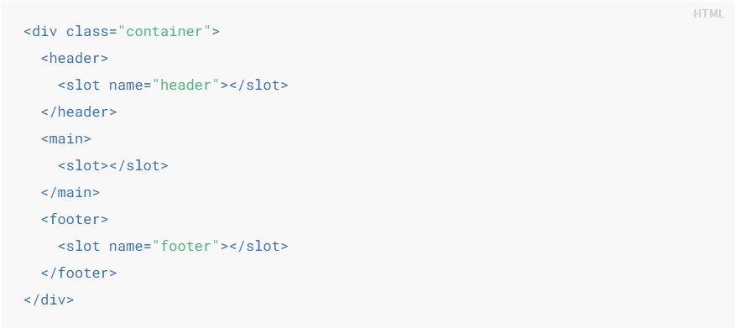
Named Slots
We can have multiple such slots in our components with each having different names

Slide 55
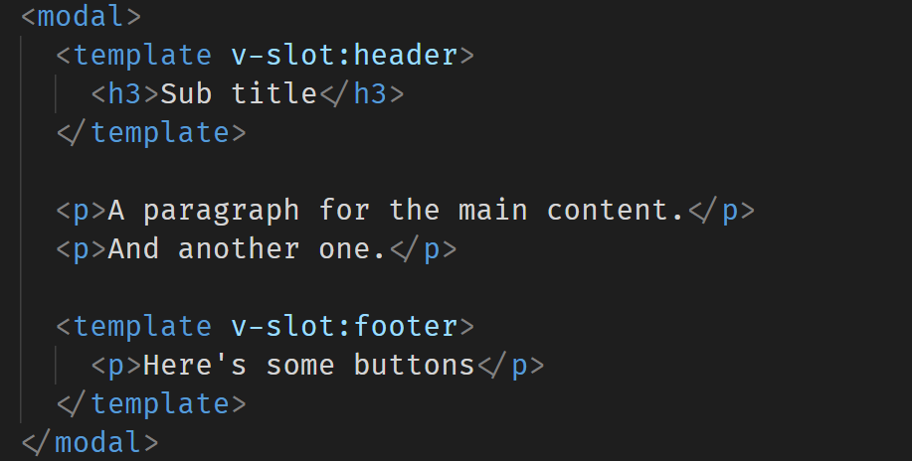
Named Slots
We use v-slot:<slot-name> on the wrapper template tag to pass the items into that particular slot.

Slide 56
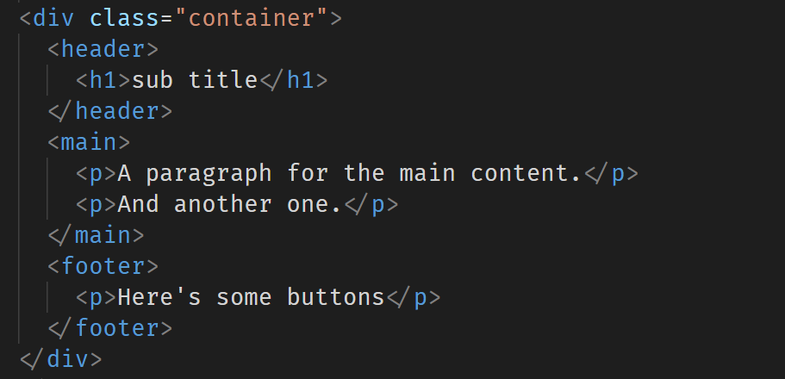
Named Slots
Final rendered structure

Slide 57
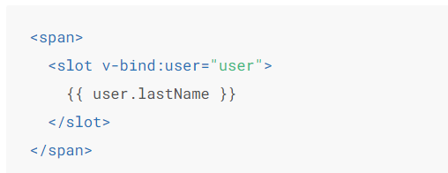
Scoped Slots
The content inside the slots by default can only access parent data and not child data. To give these slots access to child data we have pass props called as slot props

Slide 58
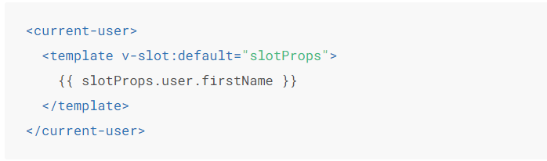
Scoped Slots
Accessing these slot props (the data passed from child component) In our component
We use v-slot:<slot-name>=“anyName”

Slide 59

Class Binding
We can bind reactive properties or computed properties to ‘class’ attribute to apply different CSS styles dynamically.
Binding Single classes
Binding class object

Slide 60
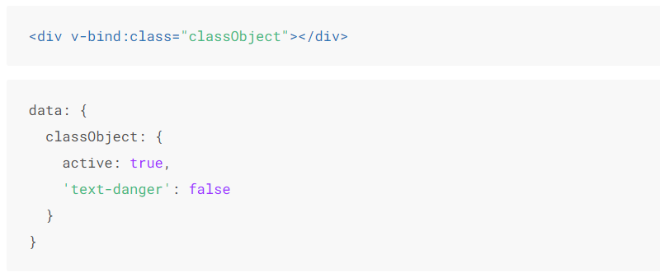
Class Binding

Slide 61
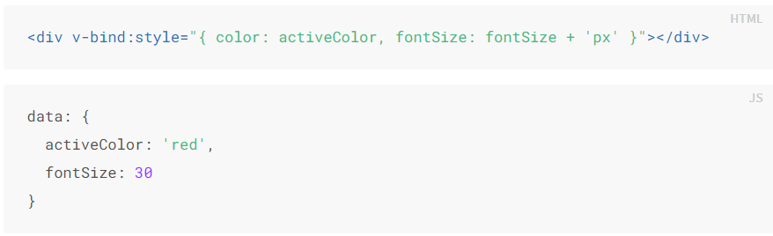
Style Binding
We can bind reactive properties or computed properties to ‘style’ attribute to apply different CSS styles dynamically.
Binding Single style
Binding style object

Slide 62
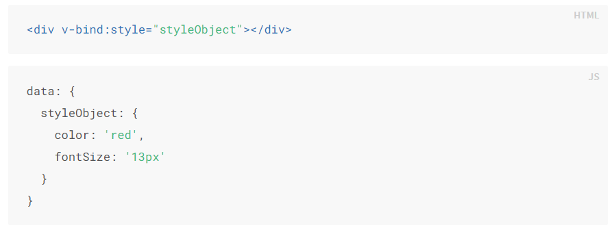
Style Binding

Slide 63
Form Binding
Different input elements different kinds of data type bindings
Input: string, number
Textarea: String
Checkbox/s: Boolean, Array, String
Radio: string, number
Select: string, number
Multi Select: Array

Slide 64

Event Modifiers
It is a very common need to call event.preventDefault() or event.stopPropagation() inside event handlers. Although we can do this easily inside methods, it would be better if the methods can be purely about data logic rather than having to deal with DOM event details.
Commonly used event modifiers:
.stop
.prevent
.once
.self
.left, .right, .middle

Slide 65
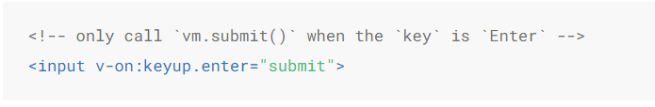
Key Modifiers
Commonly used key modifiers:
.enter
.tab
.left, right, .down, .up
.ctrl
.alt
Keyup.(any key code here)

Slide 66
Mixins
Mixins are a flexible way to distribute reusable functionalities for Vue components. A mixin object can contain any component options.
When a component uses a mixin, all options in the mixin will be “mixed” into the component’s own options.
The component’s options will take priority during conflicts

Slide 67
Mixins
Mixins are a flexible way to distribute reusable functionalities for Vue components. A mixin object can contain any component options.
When a component uses a mixin, all options in the mixin will be “mixed” into the component’s own options.
The component’s options will take priority during conflicts

Slide 68
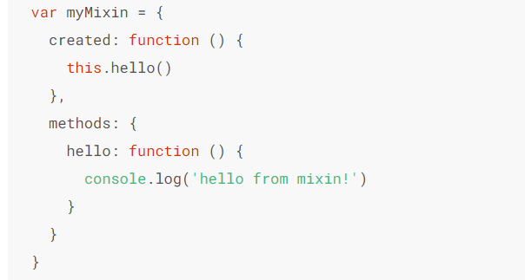
Mixins
Mixins/index.js – We export an object which consists of shared Vue options such as data, methods, life cycle hooks etc

Slide 69
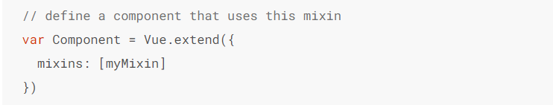
Mixins
We can import these exported mixins in any component that requires these options

Slide 70
API Calls
We use ‘Axios’ library to make API calls.
Axios is a promise based JavaScript library to make REST API calls.
Install Axios as a production dependency using the command below:
npm install --save axios
Notes:
https://fakestoreapi.com/

Slide 71
REST (Representational state transfer)
REST is software Architectural style which follows the constraints given below
REST APIs communicate via HTTP requests to perform standard database functions like creating, reading, updating, and deleting records (also known as CRUD)
Common Data sharing Formats: JSON, XML
REST main principles:
Client-server decoupling
Statelessness
Cacheable
Uniform Interface
Notes:
https://fakestoreapi.com/
Client -> The one who requests the information
Server -> The one who stores the information
Easy scaling, changing or modifications individually. (Each of them don’t need to anything about each other)
Stateless -> Server should not store any client session data. (each request should have some kind of auth mechanism) All the information should be contained in the request.
Client can store the Auth info
Cacheable -> Client should be able to cache the requests (the server can send cache-control header and let the client know if this request can be cached or not)
Improves the app speed and performance
Uniform Interface -> Each different client device should not require different way to interect with server. All of them should be able to use the same doc and access the server in the same way.
URL -> same URL

Slide 72
Resource request methods
HTTP Verb | CRUD
POST | Create
GET | Read
PUT | Update/Replace
PATCH | Update/Modify
DELETE | Delete
Notes:
Many servers use PUT and PATCH interchangeably

Slide 73
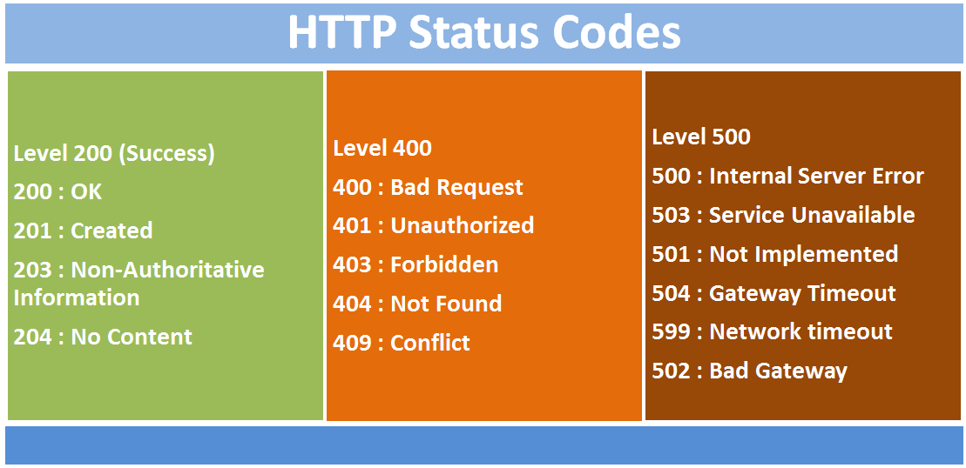
Status Codes
Notes:
200 range are Success status
400 range are Client Errors
500 range are Server Errors
300 range mostly indicates redirects (301 moved permanently)
204 -> indicates that the server has successfully fulfilled the request and that there is no content to send in the response payload body.
203 -> The request was successful but the enclosed payload has been modified from that of the origin server's 200 OK response by a transforming proxy
409 -> Conflict when you are trying to update something that is already is updated or has latest version.
502 -> (Bad Gateway) status code indicates that the server, while acting as a gateway or proxy, received an invalid response from an inbound server it accessed while attempting to fulfill the request.

Slide 74
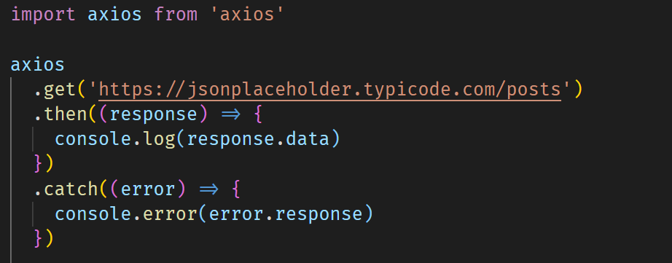
GET Request

Slide 75
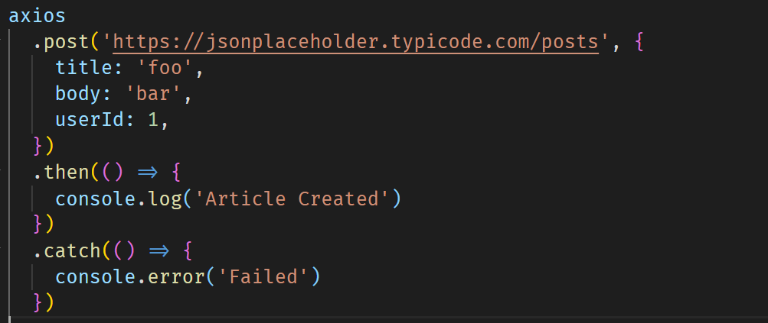
Passing Body to Requests

Slide 76
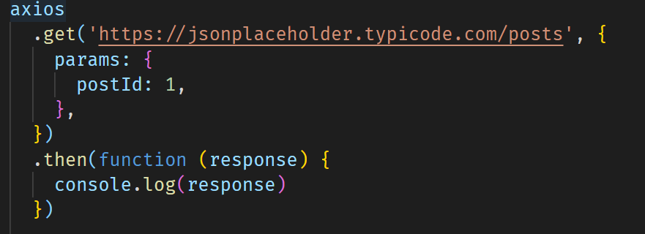
Passing Query Params

Slide 77
Custom Axios Instance
We can create custom axios instance with predefined values for that instance such as
Base URL
Headers
Timeouts
Auth Tokens
And more -> https://github.com/axios/axios#creating-an-instance

Slide 78
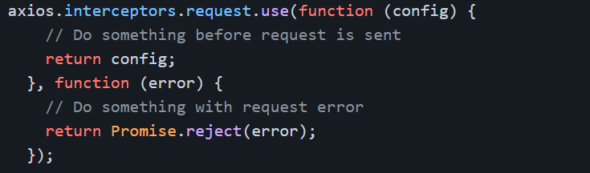
Axios Interceptors
We can intercept each and every requests or responses from Axios to make any kind of operations
Eg: Intercept all failed requests and show an error toast

Slide 79
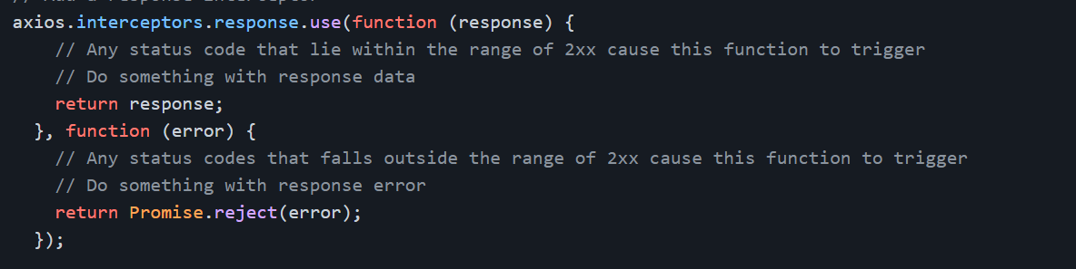
Axios Interceptors
Intercepting Reponses

Slide 80
Vue Router
Vue-router is the official router library for Vue.js
It is used to mainly to navigate between the pages.
To install Vue-router, You can either select it while creating the project or install it later with the command below:
vue add router
OR npm install vue-router --save

Slide 81
Creating the Router files
import { createRouter, createWebHistory } from 'vue-router'
const routes = []
const router = createRouter({
routes,
})
export default router

Slide 82
Importing Vue Router to our Project
//main.js
import { createApp } from 'vue'
import App from './App.vue'
import router from './router'
createApp(App).use(router).mount('#app')

Slide 83
Importing Vue Router to our Project
import Home from '@/views/Home.vue'
const routes = [
{
path: '/',
name: 'home',
component: Home,
},
{
path: '/about',
name: 'about',
component: () =>
import(/* webpackChunkName: "about" */ '../views/About.vue'),
},
]
Each route should have:
Path (unique)
Name (unique)
Component

Slide 84
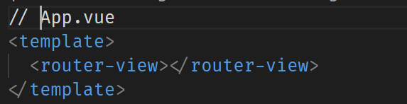
Router Entry point
<router-view> component is the main entry point and should be placed in App.vue

Slide 85
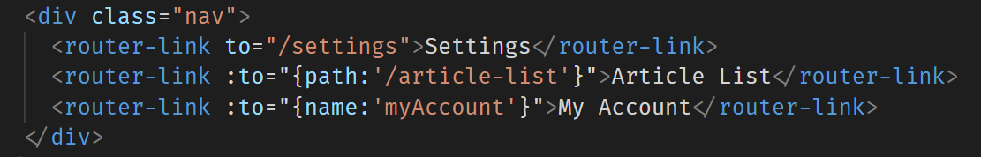
Router Links
<router-link> component is used to create links. ‘to’ attribute takes the path to which the link should be directed to.

Slide 86
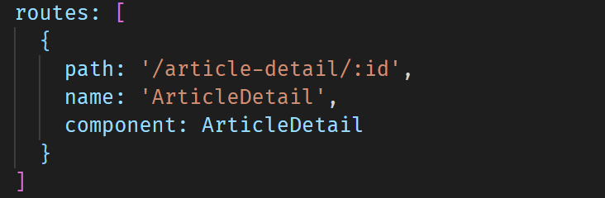
Dynamic Routing
Routes can dynamic URL Parameters which can then accessible in the pages. In the below example ‘id’ is the dynamic parameter.

Slide 87
Additional Query Parameters
We can also send a query parameter to any existing route which can later be accessed in the component
Eg: https://example.com/article-detail/2?showEdit=true

Slide 88
Accessing Router Data in Components
Vue-router injects two useful objects $route and $router which can be accessed in any Vue components.
$route gives us information about the dynamic parameters, query params, current route etc.
$router is used to programmatically navigate to different routes.

Slide 89
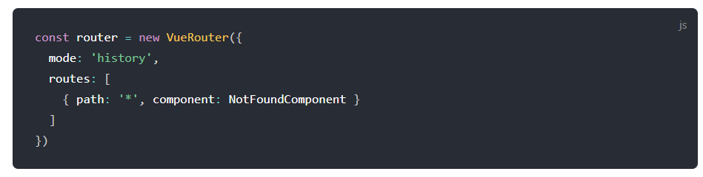
404 route
When the URL doesn’t match to any routes defined we can show a 404 page.

Slide 90
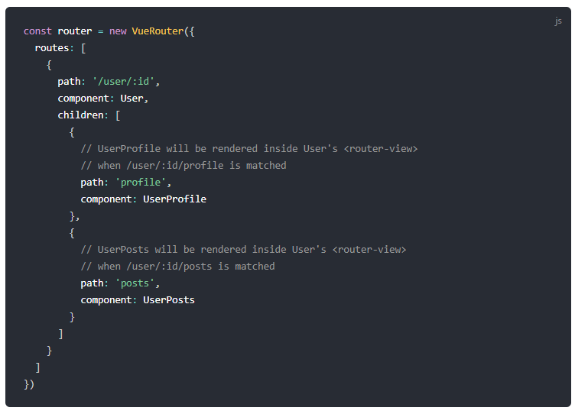
Child Routes
We can also nest one route inside the other using the concept of child routes.

Slide 91
Route / Navigation Guards
As the name suggests, the navigation guards provided by vue-router are primarily used to guard navigations either by redirecting it or canceling it. 1. Global Navigation guards
2. Component Navigation guards

Slide 92
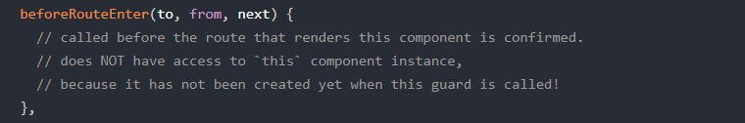
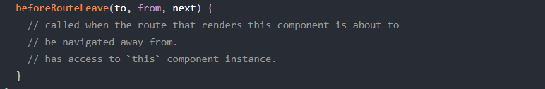
Navigation Guards - Components
These are component specific guards, (basically like a router lifecycle hook) Its important to call next() after we do any operations

Slide 93
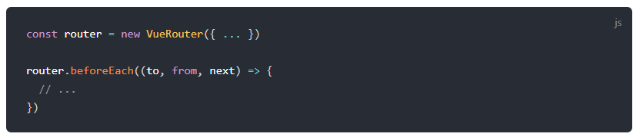
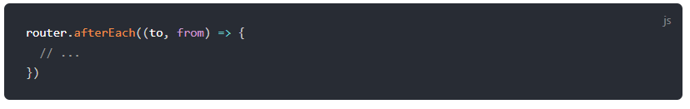
Navigation Guards - Global
These guards are written in our router file itself and can be applicable to all the routes. Its important to call next() after we do any operations.
Next() is not required for afterEach() as the route has already been changed.

Slide 94
Vuex
Vuex is a state management pattern + library for Vue.js applications.
It serves as a centralized store for all the components in an application, with rules ensuring that the state can only be mutated in a predictable fashion.
We can install Vuex using the command below:
vue add vuex
OR npm install --save vuex

Slide 95
Vuex
Vuex is a state management pattern + library for Vue.js applications.
It serves as a centralized store for all the components
Vuex stores are reactive.
You cannot directly mutate the store's state. The only way to change a store's state is by explicitly committing mutations.
Notes:
Vuex is liked a frontend

Slide 96
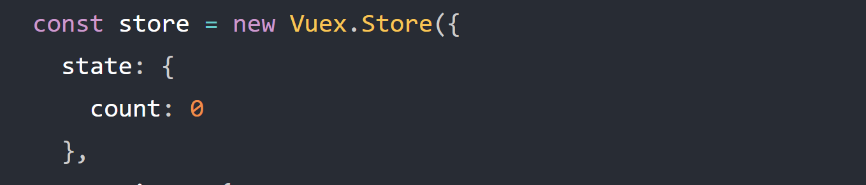
Vuex - State
State: It’s a single object contains all your application level state and serves as the "single source of truth". This also means usually you will have only one store for each application.

Slide 97
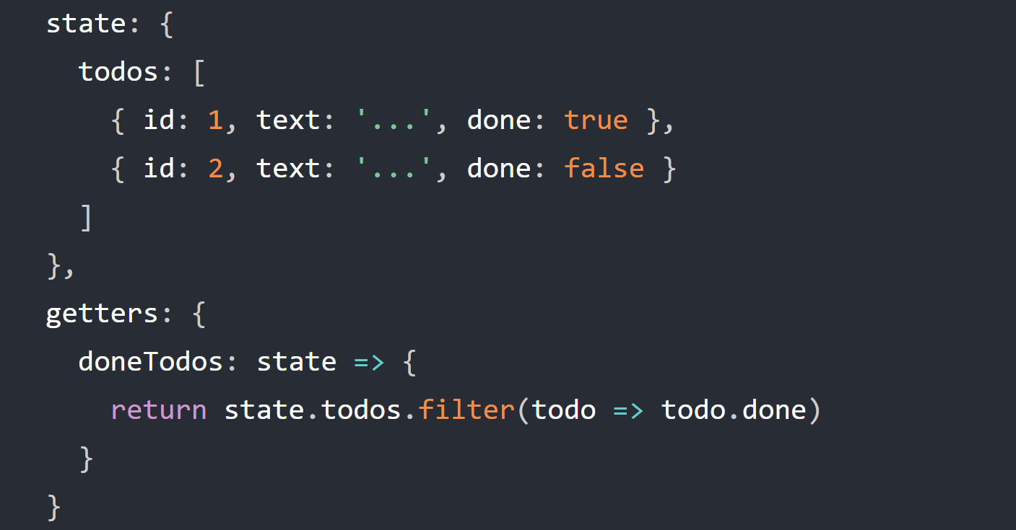
Vuex - Getters
Getters: Sometimes we may need to compute derived state based on store state.
Eg: Getting the tasks that are completed from the list of tasks

Slide 98
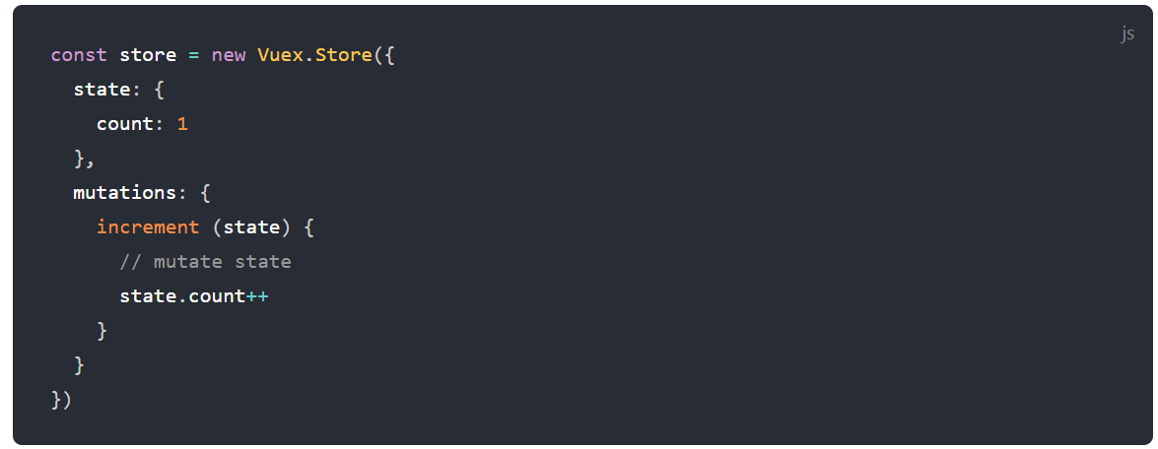
Vuex - Mutations
Mutations: The only way to actually change state in a Vuex store is by committing a mutation. It’s a synchronous function is where we perform actual state modifications, and it will receive the state as the first argument

Slide 99
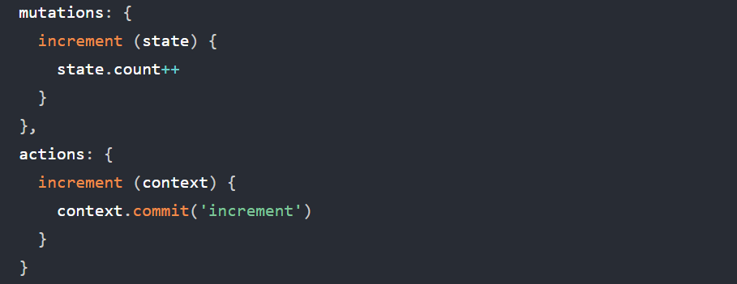
Vuex - Actions
Actions: Actions are used to perform async operations. Actions can also commit mutations.

Slide 100
Vuex
//store/index.js
import { createStore } from 'vuex'
export default createStore({
state: {},
mutations: {},
actions: {},
modules: {},
})
import { createApp } from 'vue'
import App from './App.vue'
import store from './store'
createApp(App).use(store).mount('#app')

Slide 101
Using Vuex in Components
Using the injected store (this.$store)
State: this.$store.state
Getters: this.$store.getters
Mutations: this.$store.commit(‘<mutation-name’>, payload)
Actions: this.$store.dispatch(‘<action-name’>, payload)
Using Helpers ( mapState, mapGetters, mapMutations, mapActions )

Slide 102
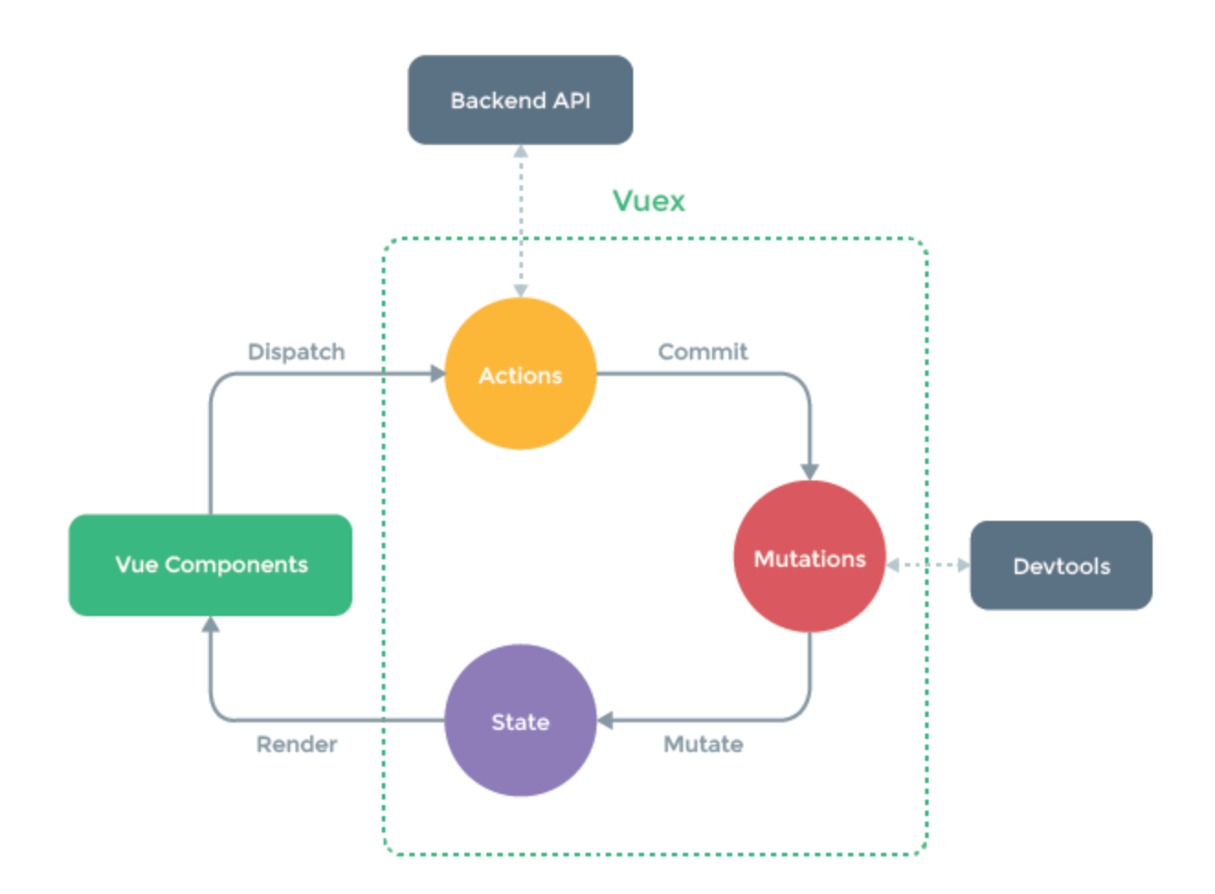
Vuex

Slide 103
Vuex - Modules
As our application grows in scale, the store can get really bloated. To help with that, Vuex allows us to divide our store into modules. Each module can contain its own state, mutations, actions, getters

Slide 104
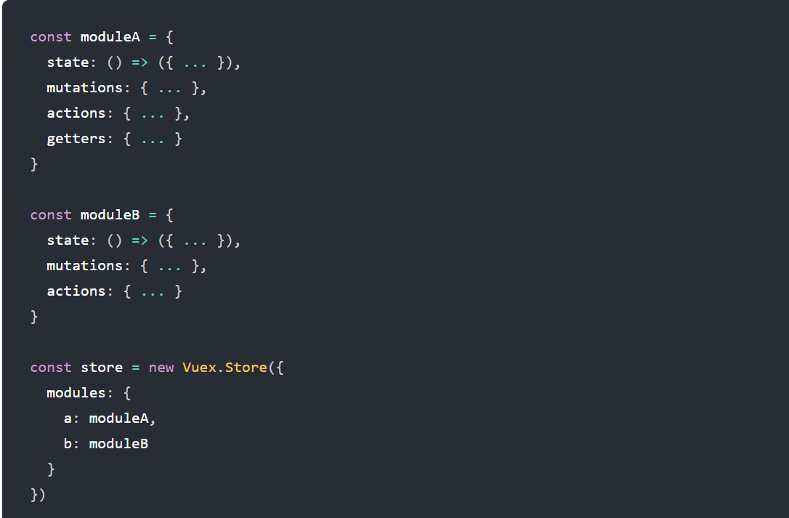
Vuex - Modules

Slide 105
Vue Localization
Localization is process of adopting the software to support multiple languages or translations.
To localize a Vue application we need ‘vue-i18n’ library
vue add i18n
OR npm install --save vue-i18n
Notes:
globalInjection: true,

Slide 106
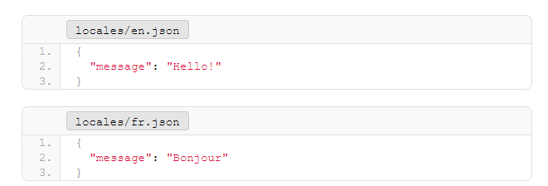
Vue Localization
We need to have src/locales folder in which we add our JSON files.

Slide 107
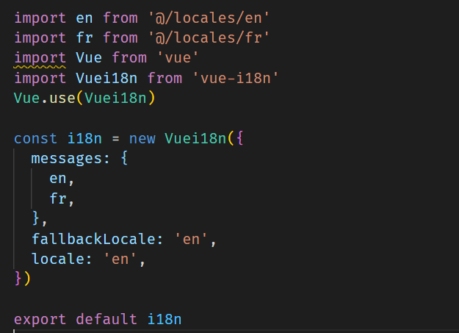
Vue Localization - setup

Slide 108
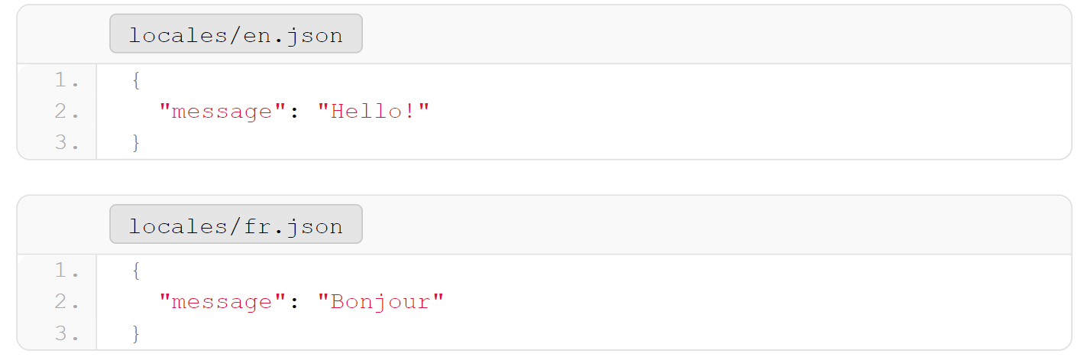
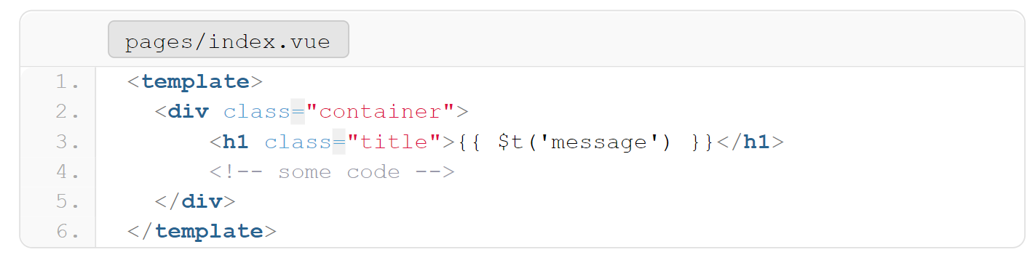
Using the locale strings in Components

Slide 109
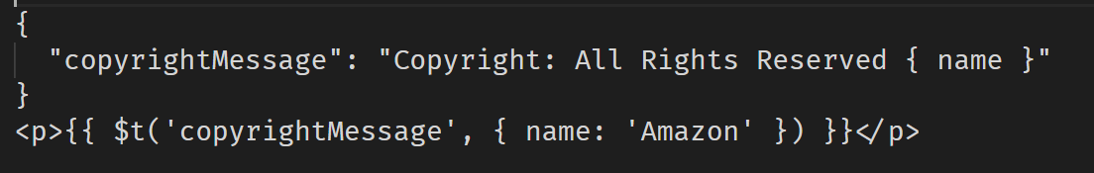
Named Formatting
There are instances where not every word would need to be translated, such as proper nouns (first or family names, places), URLs, etc. To avoid duplicating them all in every locale file, we can apply the name-formatting technique.

Slide 110
Building locale switcher
Vue-i18n will inject the property $i18n we can access that using
this.$i18n in JavaScript or directly $i18n on our <template>
$i18n.locale -> Gives the currently selected locale

Slide 111

Building locale switcher

Slide 112
Named Formatting
There are instances where not every word would need to be translated, such as proper nouns (first or family names, places), URLs, etc. To avoid duplicating them all in every locale file, we can apply the name-formatting technique.

Slide 113
Pluralization
It is oftentimes difficult to predict quantity without actual data. To achieve Pluralization, we can pass the quantity value, and the package will send the appropriate translation.
We have to use $tc() method

Slide 114

Pluralization

Slide 115
Number localization
Different languages and regions represent numbers in different ways.
Currency
Date-time
We have to pass numberFormats object to the vue-i18n instance where we can define all our number formats.
We use $n() method

Slide 116


Number localization - Currency

Slide 117
Date localization
Different languages and regions represent date and time in different ways.
We have to pass dateTimeFormats object to the vue-i18n instance where we can define all our number formats.
We use $d() method

Slide 118

Date localization

Slide 119
Unit Testing
UNIT TESTING is a type of software testing where individual units or components of a software are tested. The purpose is to validate that each unit of the software code performs as expected.
Testing is done during the development (coding phase) of an application by the developers.

Slide 120
Purpose of writing Unit Tests
Unit test is written to verify expected behavior
It avoids breaking existing functionalities.
Unit tests act as documentation
Improves Confidence of developers
Unit test is NOT a replacement for Manual testing or QA
Notes:
So what is the purpose of writing unit tests?
Remember unit tests are not written to find bugs
If you make some changes which breaks existing functionality, your unit tests break, you can easily find out by examining the failed unit tests without manually testing all the features
In large apps it would be hard to figure out what the component does by just going through it, but a good unit test suite will help in understanding the functionality easily
When developers don’t have to worry about their changes breaking existing features, they’ll have more confidence in coding

Slide 121

Knowing What to Test
Black Box Testing is a software testing method in which the functionalities of software applications are tested without having knowledge of internal code structure. We only test for the output rather the internal implementation

Slide 122

How to approach Unit Testing in Vue
We test using the concept of a component contract ( a.k.a Blackbox testing )
Notes:
A contract is like an agreement, something like you provide me this input and I’ll provide you this output
You are only interested in output and not the way in which the output is arrived.
Here is a simple function which returns the prime numbers in a given range, we can write different logics to arrive at the solution
To test this function, you should see only the input and output and a black box covering the implementation.
In this way, we don’t test any implementation details so developers will have more freedom to refactor without breaking the test

Slide 123
Installing Packages
Vue-test-utils: Vue Test Utils is the official unit testing utility library for Vue.js. This library gives us Vue specific helper functions.
Jest: JavaScript Testing Framework that gives us useful generic built-in functions such as assertions, matchers etc.
vue add unit-jest
VS-Code extensions: Jest, Jest Runner

Slide 124


How does a Unit Test looks like?
Notes:
Here is a simple add function which takes two numbers as input and returns the sum
To test this
First we import our test subject, i.e. our add function
We write a meaningful description as to what we are testing
We pass two numbers to our add function, in this case 3 and 4 and expect the output 7

Slide 125


How a Unit Test looks like?
Notes:
When we run this test, we see that our test pass successfully

Slide 126

What is code Coverage?
Notes:
So what exacly is this code coverage? We got 100% coverage in our test application, does it mean it is fully tested and bug free?
Lets assume our small application is ready for production and we pass it to QA
Will the QA test for 3 and 4? Never, their test case would be something like this and you’ll get a big list of bug reports.

Slide 127
Code Coverage Gotchas
Coverage just says that x % of lines in test document is covered in your unit test scripts.
A 100% coverage doesn’t mean it’s 100% bug free
It is not necessary to have 100% coverage

Slide 128
How to approach Unit Testing in Vue
Possible Inputs: props, store, user actions
Possible Outputs: state, action ( function call etc.), UI Change

Slide 129
Vue test utils
mount() -> Mount method renders the entire component all with all of its child and all the nested components.
shallowMount() -> shallowMount method only renders the component and its 1st level child component only

Slide 130

Vue test utils
mount() ->

Slide 131

Vue test utils
shallowMount() ->

Slide 132
Things to Note
Test have to be independent of each other
Never Make API or Web Service calls in Unit Tests
Give a meaningful name for each test – It should clearly communicate the intent
Run your tests before you commit your code
Update the tests when you update the components
Notes:
Let’s say you are testing a popup dialog box. In your first text you test if the popup successfully opens on click of a button. In the second test, if you want to test something like if the login button is rendered, You still have to trigger the popup open button.

Slide 133
Things to Test
Testing Components and rendered data
Testing Events (like click, input etc)
Testing Slots rendering
Testing Vuex Store
Testing Vuex in Components
Testing injected functions like $router, $emit etc

Slide 134
Unit Test terms
Mocks: A mock is concerned with create a fake object/item which has almost all the properties or methods like the real one.
Stub: Stub is like mock, but can only have what is required instead of the whole object
Spy: A Spy is a object that generally wraps your original object or your fake object and give out some useful methods where you can access the behavior such as if the spy was called, how many times, etc

